Slide 1
IRIS CLASSIFIER
Ml INTERMEDIATE Term3 Project
By: Raj gupta (Aug cohort batch)

Slide 2
Problem statement / Data collection
For this problem, dataset is provided by INSAID
In this dataset, task is to build a model to predict the Species of a flower and classify it
Species of a flower can be of three types:
Iris-setosa
Iris-versicolor
Iris-virginica

Slide 3
Data description
Dataset includes three iris species with 50 samples each as well as some properties about each flower. One flower species is linearly separable from the other two, but the other two are not linearly separable from each other.
The columns in this dataset are:
Id
SepalLengthCm
SepalWidthCm
PetalLengthCm
PetalWidthCm
Species

Slide 4
missing data imputation
There is no missing value in the dataset
Each column contains 150 values

Slide 5
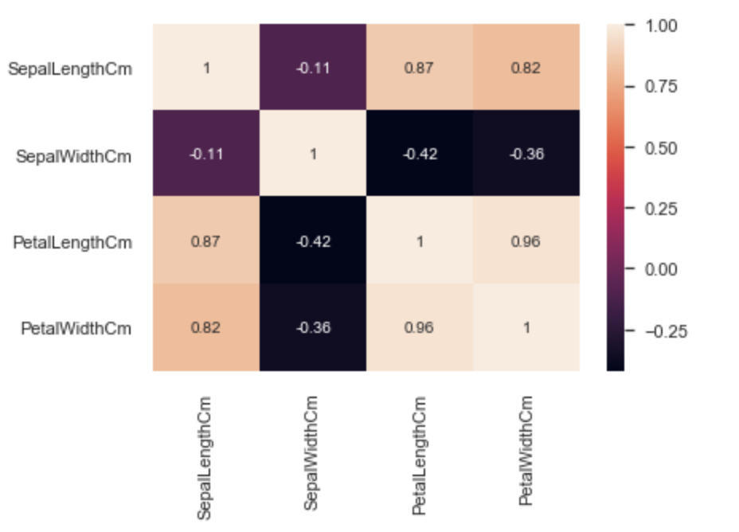
Correlation using heatmap

Slide 6
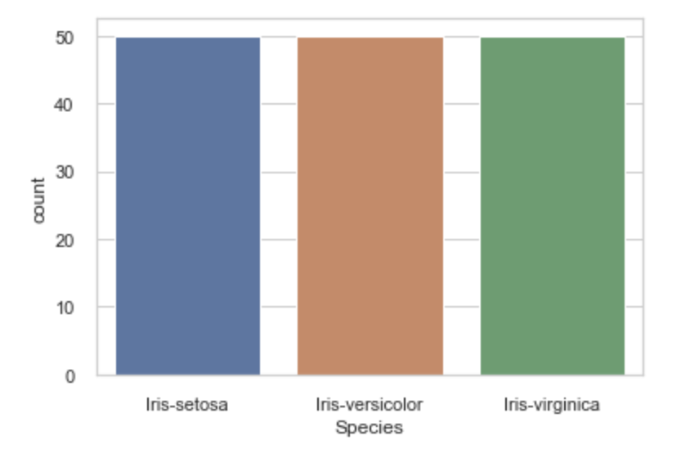
target variable - “SPECIES”
The Species column data is equally divided into 3 classes and having 50 samples of each class.

Slide 7
EDA
Response value was higher for lower insured age and it decreased with age. This indicates that the people with lower age were preferred compared to old people.
Insured Age seems to be tending to a normal distribution with insurance age between 20 – 60 being max.
Also, people with less (not low) weight have higher response level. Same goes for BMI.
This gives us an indication that they prefer healthy people to provide the insurance.

Slide 8
model building
Since target variable is a Categorical variable with 3 classes, it is a multi class classification problem.
ML algorithms used for model building are:
Logistic Regression
Decision Tree
Random Forest
KNN
Naïve Bayes
Support Vector Machine

Slide 9
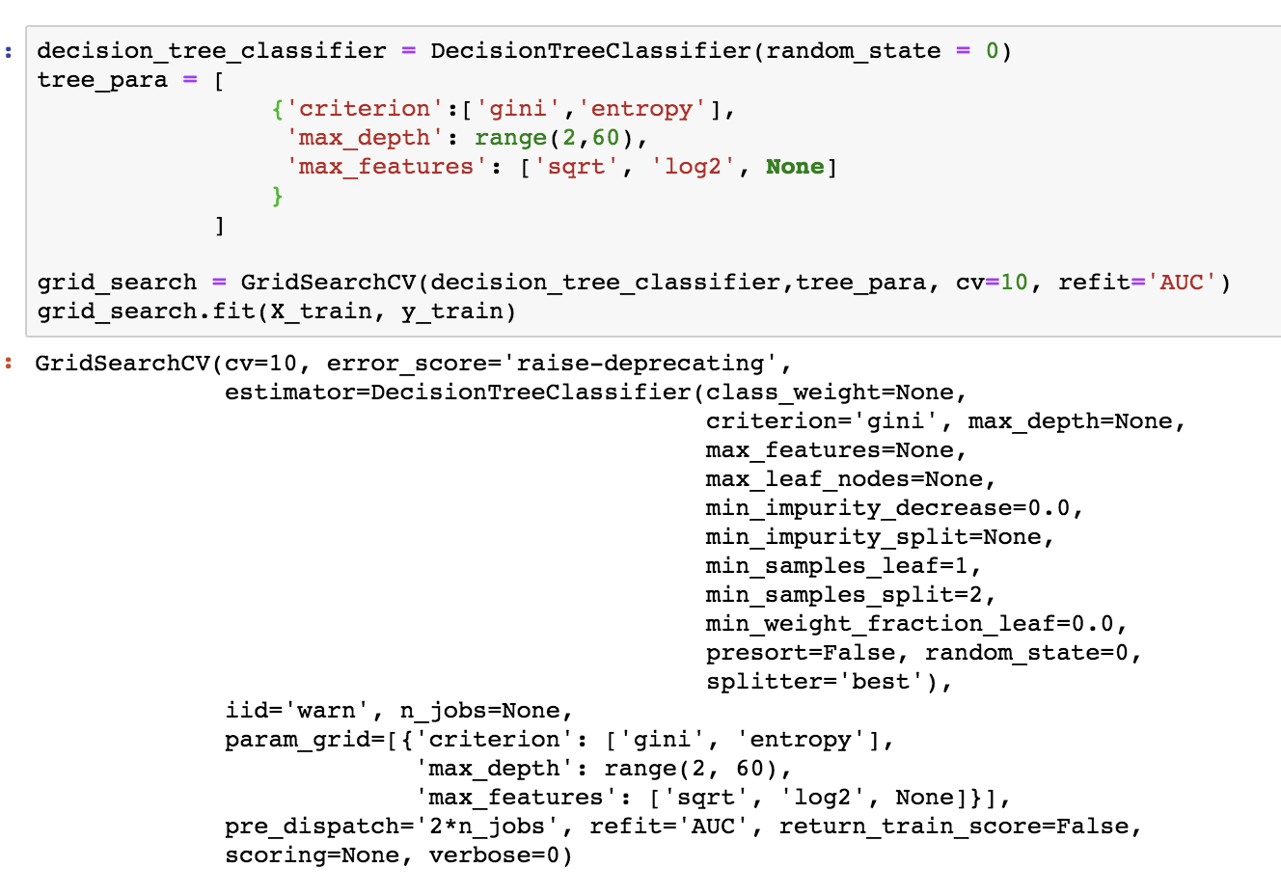
Decision Tree Classifier

Slide 10
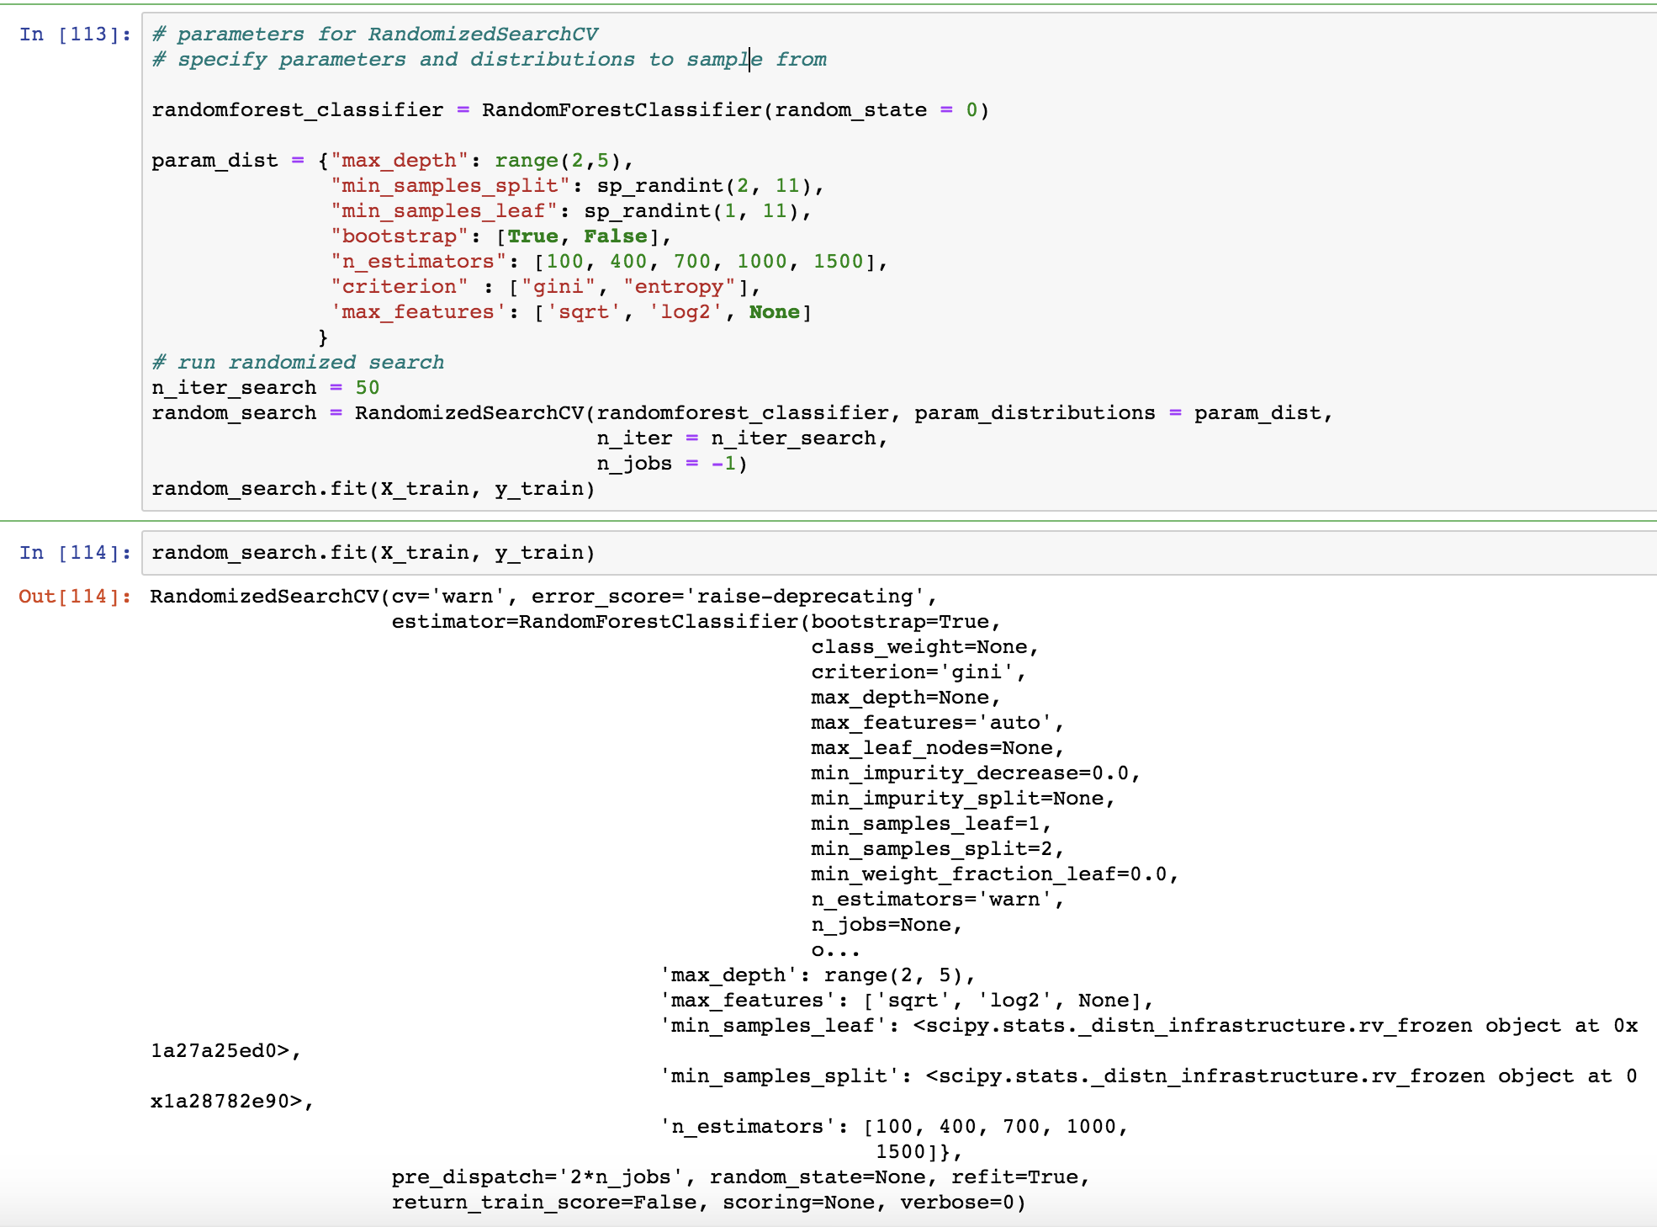
Random Forest Classifier

Slide 11
Model evaluation
For a classification problem, we will evaluate the models based on:
Confusion Matrix
Accuracy Score
Precision
Recall
F1 score

Slide 12
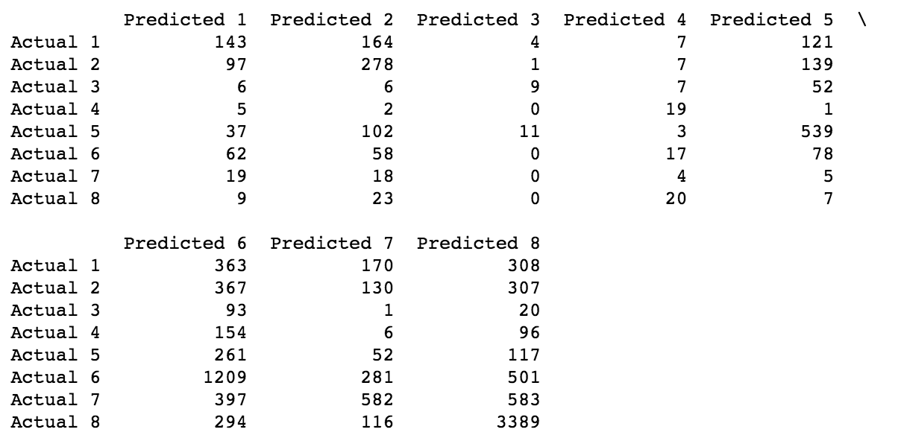
CONFUSION MATRIX of decision tree classifier

Slide 13
ACCURACY SCORE
Using Base Model Model Name | Train Accuracy (%) | Test Accuracy (%)
Logistic Regression | 49.2 | 47.9
Decision Tree | 100 | 40.3
Random Forest | 98.9 | 48.4
Using GridSearchCV Model Name | Train Accuracy (%) | Test Accuracy (%)
Decision Tree | 53.9 | 51.9
Random Forest | 48.4 | 48.6

Slide 14
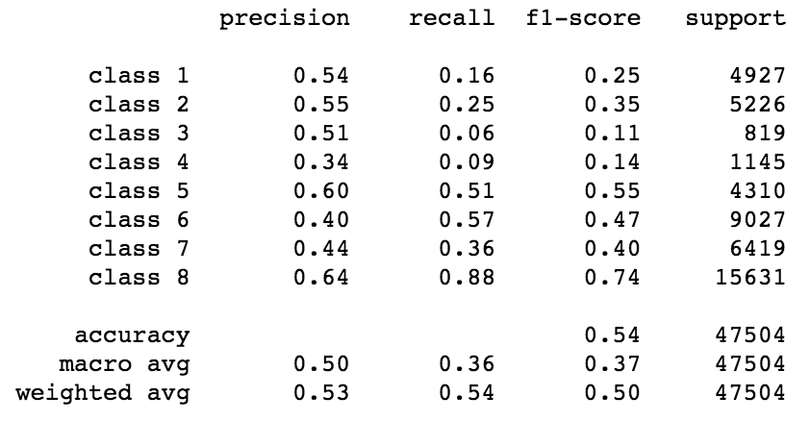
CLASSIFICATION REPORT of decision tree classifier

Slide 15
conclusion
We have built the model to precisely predict Response variable so that life insurance applications can be scrutinized easily, and correct decision be made.
We have compared the performance of the models using various model evaluation techniques.
Model evaluation step shows Decision Tree Classifier model is more suitable for this dataset.
After Decision tree, Random Forest Classifier also has very good accuracy score.
Advanced model techniques like xgBoost, neural network can be applied to further improve model accuracy.

